Slide 1
Pacifica Bay Community Park
Remodel Update

Slide 2
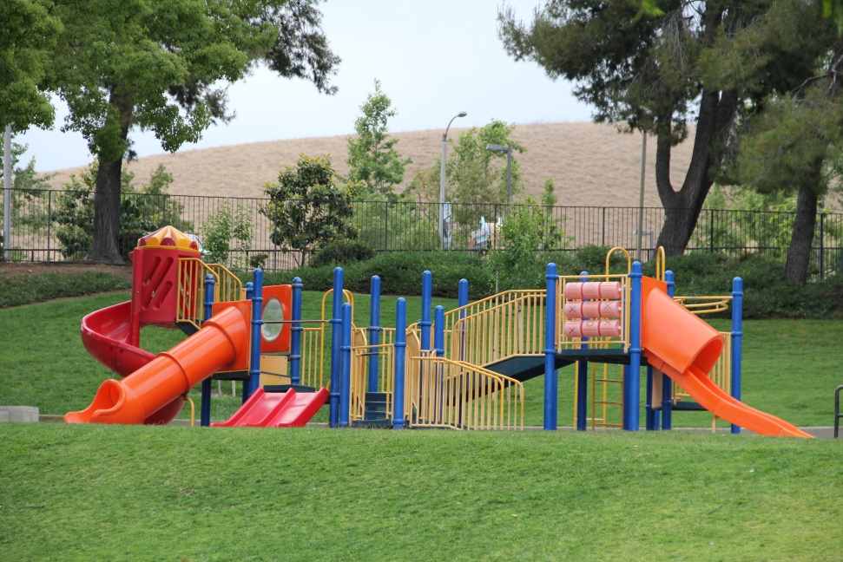
The remodel is complete!
New playgrounds and volleyball court
Two new baseball diamonds
One new soccer field
New concessions
No change to the lake and waterfall

Slide 3
Relax in the Shade!

Slide 4
Winter Park Happenings
Sports
Youth Softball League
Adult Volleyball League
Snow Day
Events
Festival of Winter Lights

Slide 5
Pacifica Bay Parks and Recreation
For Additional Information
Contact Connie Torres 714-555-0031

